Slide 1
Graphics
Cathode Ray Tube

Slide 2
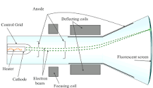
A cathode-ray tube (CRT) is a vacuum tube containing one or more electron guns, the beams of which are manipulated to display images on a phosphorescent screen. The images may represent electrical waveforms (oscilloscope), pictures (television set, computer monitor), radar targets, or other phenomena.

Slide 3
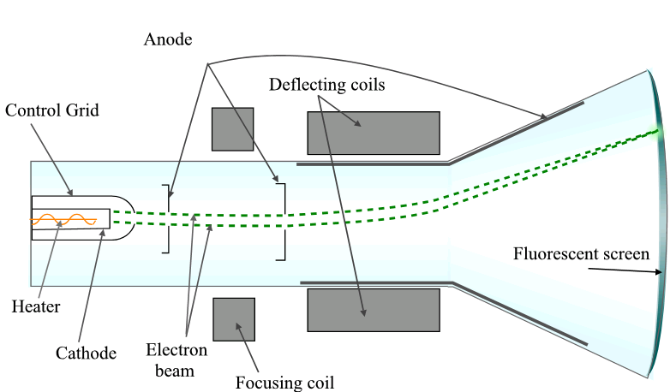

Slide 4
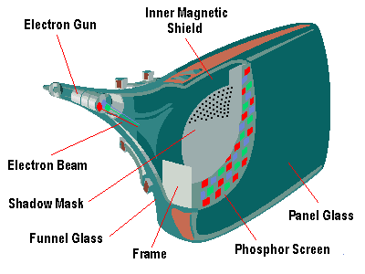

Slide 5
The first cathode ray tube scanning device was invented by the German scientist Karl Ferdinand Braun in 1897. Braun introduced a CRT with a fluorescent screen, known as the cathode ray oscilloscope. The screen would emit a visible light when struck by a beam of electrons.
The development of electronic television systems was based on the development of the cathode ray tube (CRT).

Slide 6
Cathode Ray Tube (CRT)
• The most common graphics output device is the video monitor which is based on the standard cathode ray tube (CRT) design
A cathode-ray tube (CRT) is a vacuum tube containing one or more electron guns, the beams of which are manipulated to display images on a phosphorescent screen. The images may represent electrical waveforms (oscilloscope), pictures (television set, computer monitor), radar targets, or other phenomena

Slide 7
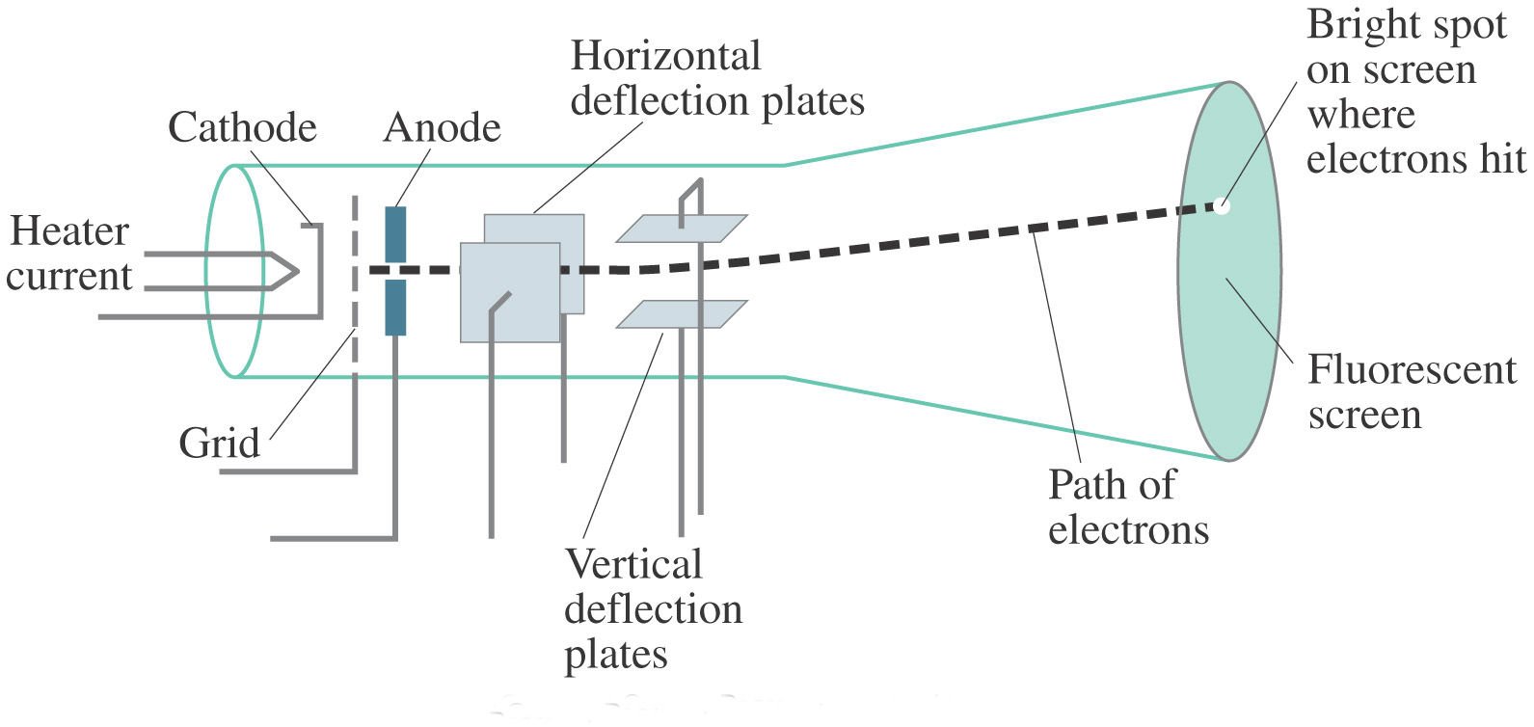

Slide 8
• As shown in above figure, it consists of electron gun, focusing system, deflection plates and a phosphor-coated screen.
• Electron gun is the primary component of a CRT. When the heat is supplied to the electron gun by directing a current, a beam of electrons emitted by an electron gun, passes through focusing and deflection systems that direct the beam toward specified positions on the phosphor-coated screen.
• The focusing system in a CRT is needed to force the electron beam to converge into a small spot as it strikes the phosphor.
• There are two pairs of deflection plates - Horizontal deflection plates and vertical deflection plates.
• One pair of plates is mounted horizontally to control the vertical deflection, and the other pair is mounted vertically to control horizontal deflection.

Slide 9
• The beam passes between the two pairs of deflection plates and positioned on the screen.
• The phosphor then emits a small spot of light at each position contacted by the electron beam.
• Because the light emitted by the phosphor fades very rapidly, some method is needed for maintaining the screen picture.
• One Way to keep the phosphor glowing is to redraw the picture repeatedly by quickly directing the electron beam back over the same points. This type of display is called a refresh CRT.

Slide 10
• In CRT monitors there are two techniques of displaying images:
Random(vector) scan display
Raster scan display

Slide 11
Electron beam is directed only to the points of the screen where a picture is to be drawn eg. Pen plotter (hard copy device).
- Refresh rate depends on the number of lines to be displayed.
- Picture definition is stored as a set of line drawing commands in system memory called display file (or display program or display list).
- To display a specified picture the system cycles through the set of commands in display file, drawing each component line in turn. After all line drawing commands have been processed, the system cycles back to the first line command in the list.
–
- Random scan displays are designed to draw all the components of a picture 30 to 60 times each second.

Slide 12
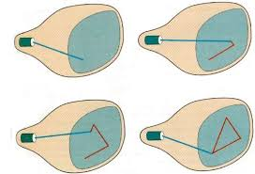

Slide 13
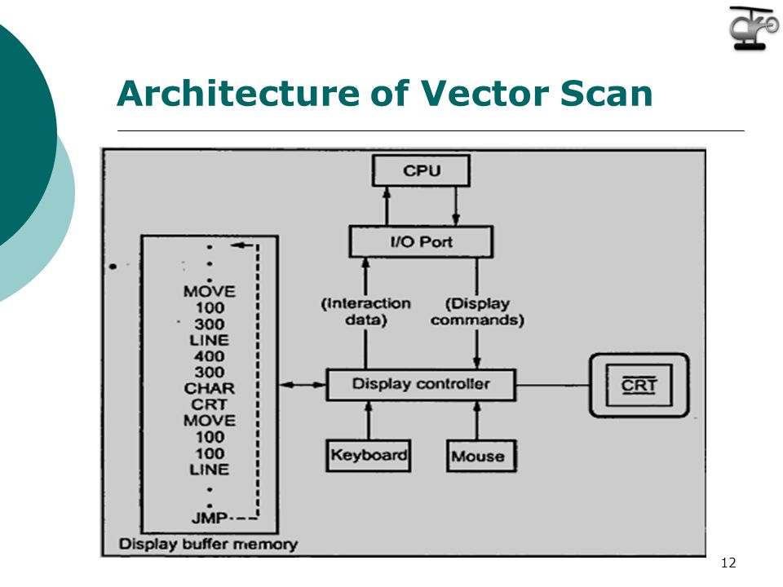

Slide 14
Advantage
High resolution & better time interval.
Better than raster for animation, requires only end point information.
produces smooth line.
-- Random scan displays are designed to draw all the components of a picture 30 to 60 times each second

Slide 15
Disadvantage
can’t fill area with patterns and manipulate bits.
Random scan monitors cannot display realistic shades scenes.

Slide 16
